Slide 1

Understanding Basic Logic Gates and Circuits

Slide 2
Introduction
Define what logic gates are?
Logic gates are the fundamental building blocks of digital electronics.
They are devices that perform logical operations on one or more binary inputs to produce a single binary output.
Each type of logic gate corresponds to a basic logical function, such as AND, OR, NOT, NAND, NOR, and XOR, and they are used to create complex circuits and perform computations in electronic systems.

Slide 3
Explain their importance in digital circuits?
1. Transistors:
Transistors are the backbone of digital circuits. They act as electronic switches that can turn on or off, representing binary states (0 or 1). Modern digital logic gates, flip-flops, and memory cells all rely on transistors.
2. Logic Gates:
Logic gates such as AND, OR, NOT, NAND, NOR, XOR, and XNOR are used to perform basic logical operations on binary inputs to produce outputs. These gates are the building blocks of complex digital circuits.

Slide 4
3. Flip-Flops:
Flip-flops are bistable devices that store binary data. They are essential for creating memory elements in digital circuits and are used in sequential logic circuits.
4. Multiplexers and Demultiplexers:
A multiplexer (MUX) selects one of many inputs and passes it to the output based on control signals. A demultiplexer (DEMUX) takes a single input and directs it to one of several outputs.

Slide 5
5. Registers and Counters:
Registers are used to store binary data, while counters are sequential circuits that increment or decrement binary values over time.
6.Resistors, Capacitors, and Inductors:
Although more common in analog circuits, passive components like resistors, capacitors, and inductors still have roles in digital circuits, particularly in signal conditioning, filtering, and providing proper voltage levels.

Slide 6
7.Clock Signals:
A clock signal provides timing for sequential circuits. It ensures that flip-flops and other timed elements change states synchronously and predictably.
8.Buffers and Drivers:
Buffers are used to drive digital signals over long distances or to interface between different logic levels. They can also isolate circuits to prevent interference.

Slide 7
9. Comparators:
Comparators are used to compare two binary values and output a high or low signal based on which value is greater.
10. Memory Elements (ROM, RAM, Flash):
Memory elements are used to store data for later retrieval or processing. ROM (Read-Only Memory), RAM (Random Access Memory), and Flash memory are common types used in digital circuits.

Slide 8
Types of Logic Gates
1. AND GATE
2. OR GATE
3. NOT GATE
4. NAND GATE
5. NOR GATE
6. XOR GATE
7. XNOR GATE

Slide 9
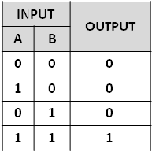
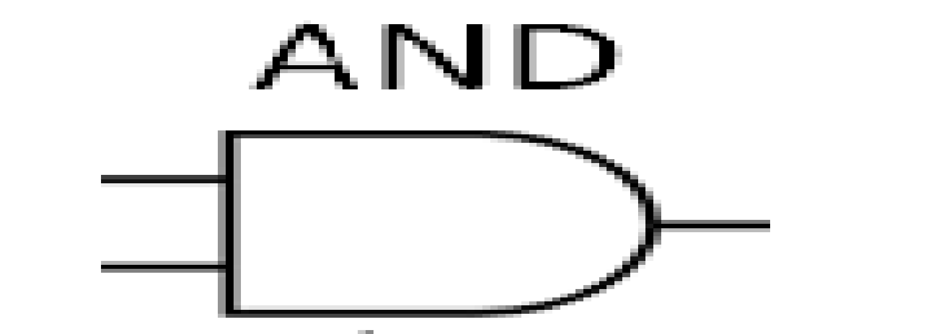
AND GATE
Function: Outputs a 1 only if all inputs are 1, otherwise outputs 0.
Inputs: A, B
Output: A AND B
Truth Table: Symbol:

Slide 10
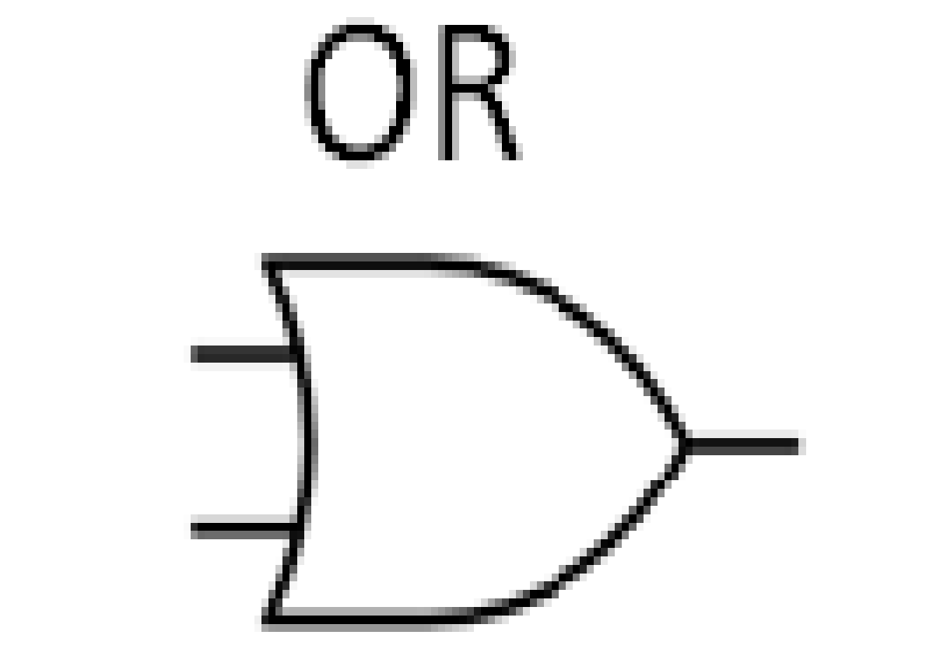
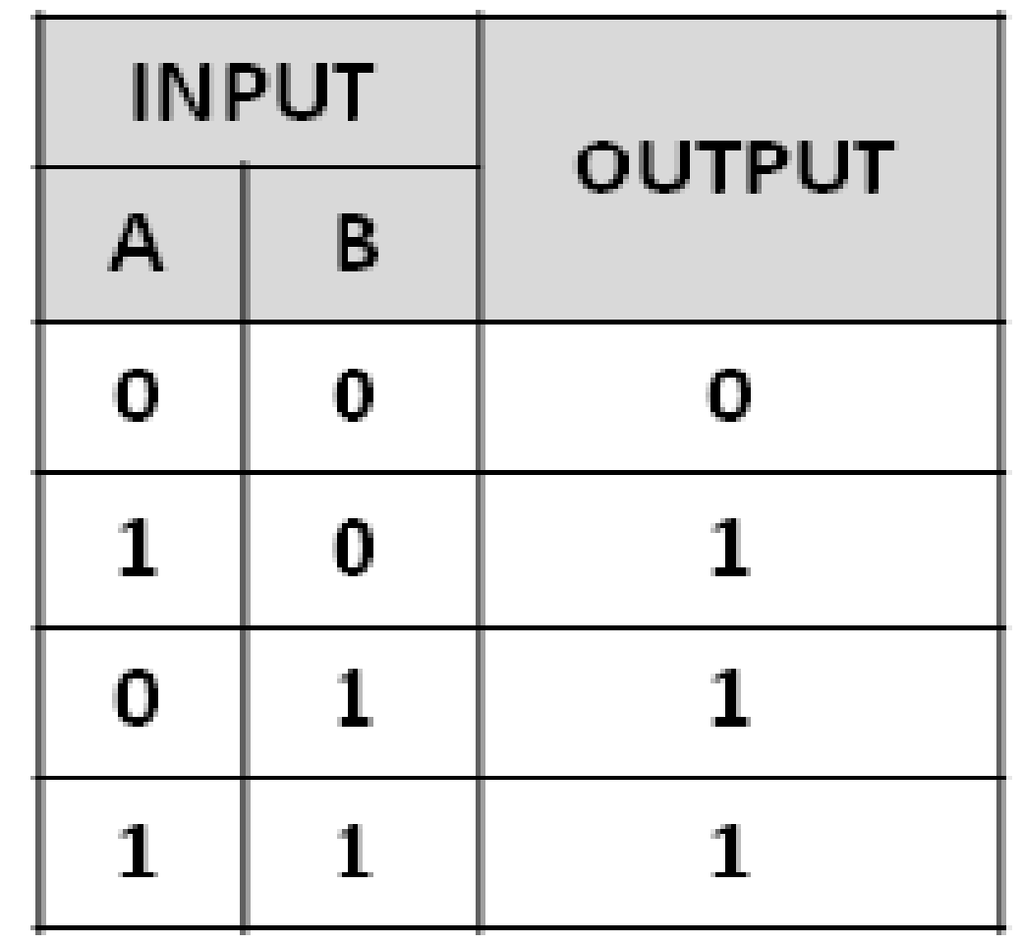
OR GATE
Function: Outputs a 1 if at least one input is 1, otherwise outputs 0.
Inputs: A, B
Output: A OR B
Truth Table: Symbol:

Slide 11
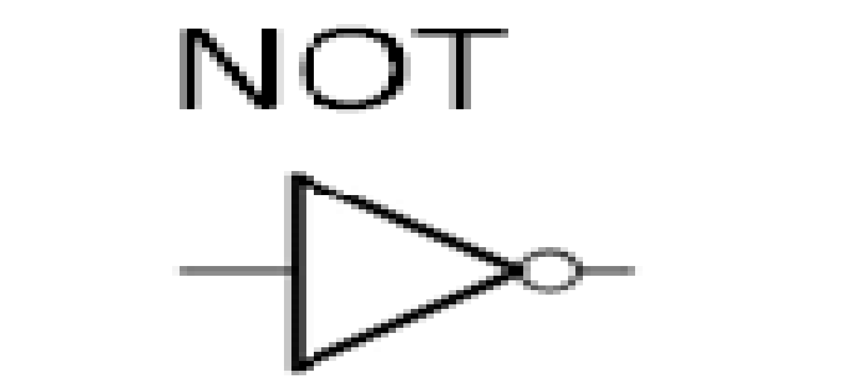
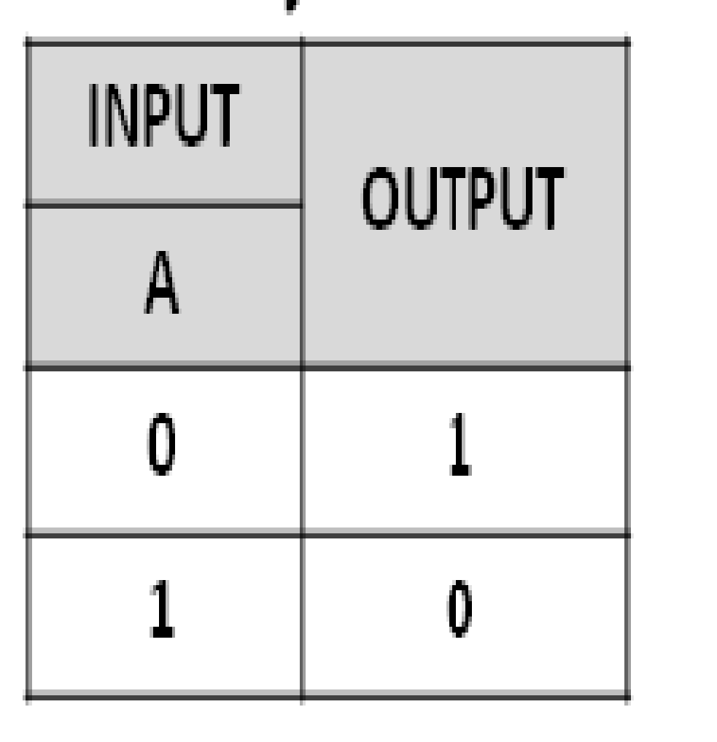
NOT Gate
Function: Outputs the opposite of the input; if input is 1, output is 0, and if input is 0, output is 1.
Input: A
Output: NOT A
Truth Table: Symbol:

Slide 12
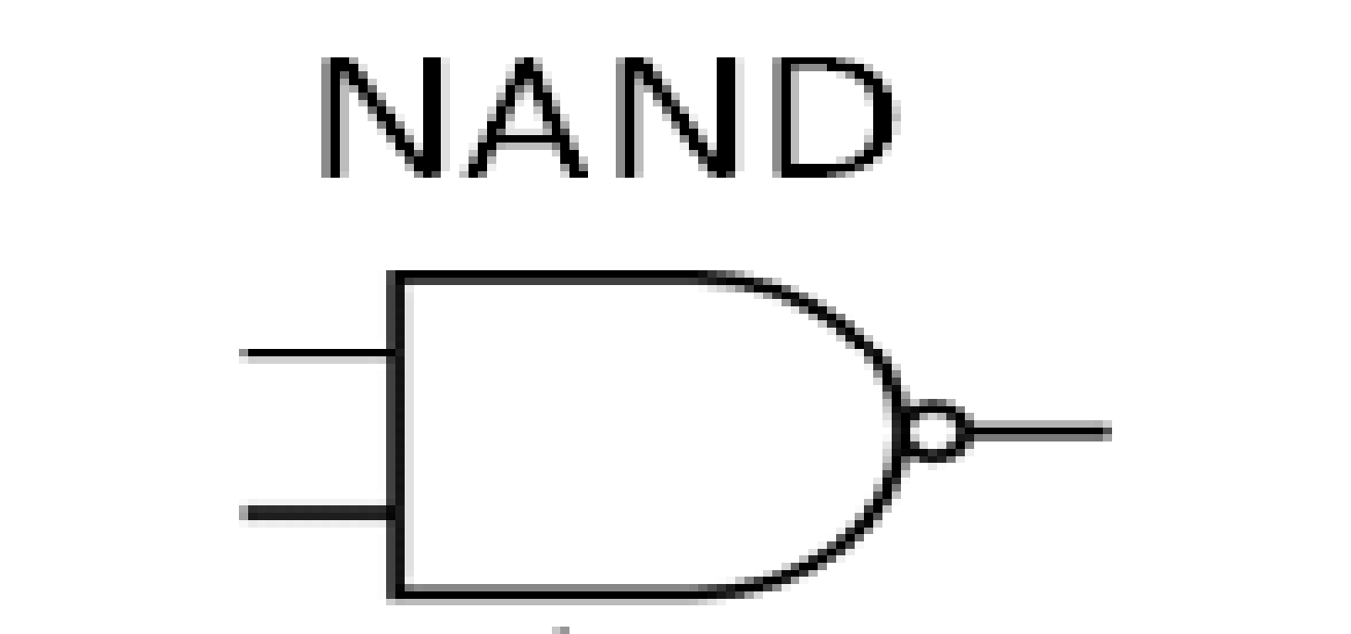
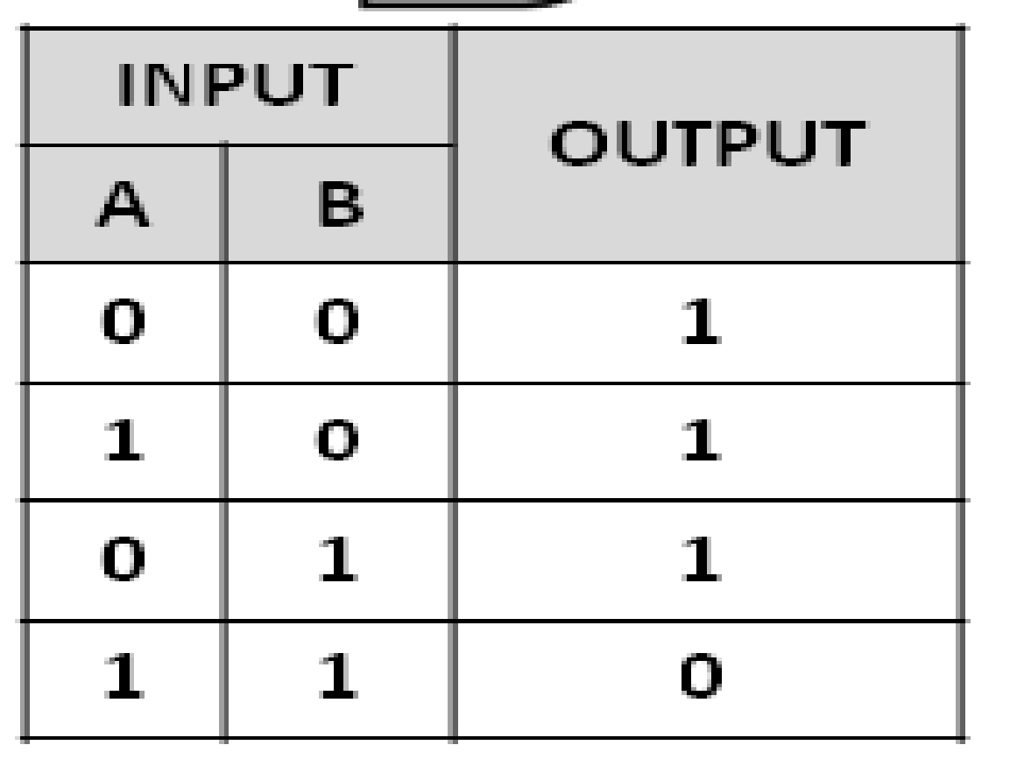
NAND Gate:
Function: Outputs a 0 only if all inputs are 1, otherwise outputs 1. It is the inverse of the AND gate.
Inputs: A, B
Output: A NAND B
Truth Table: Symobl:

Slide 13
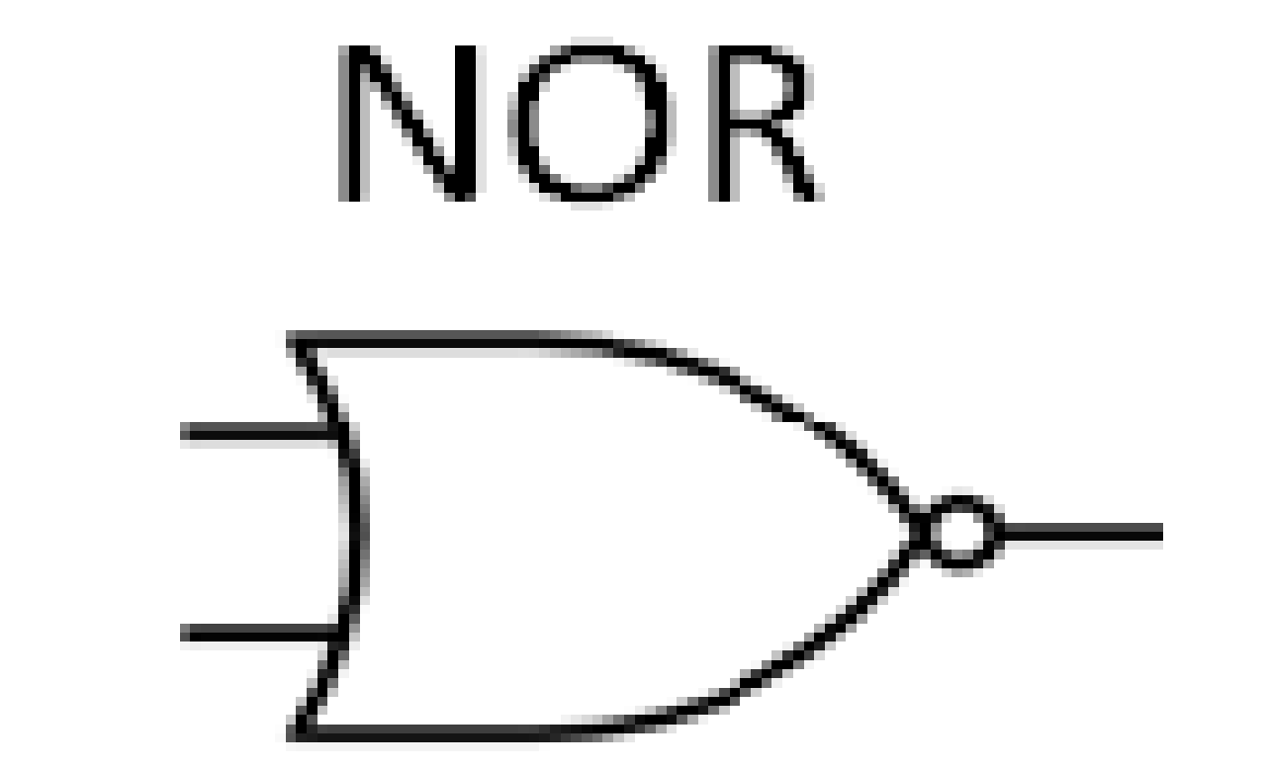
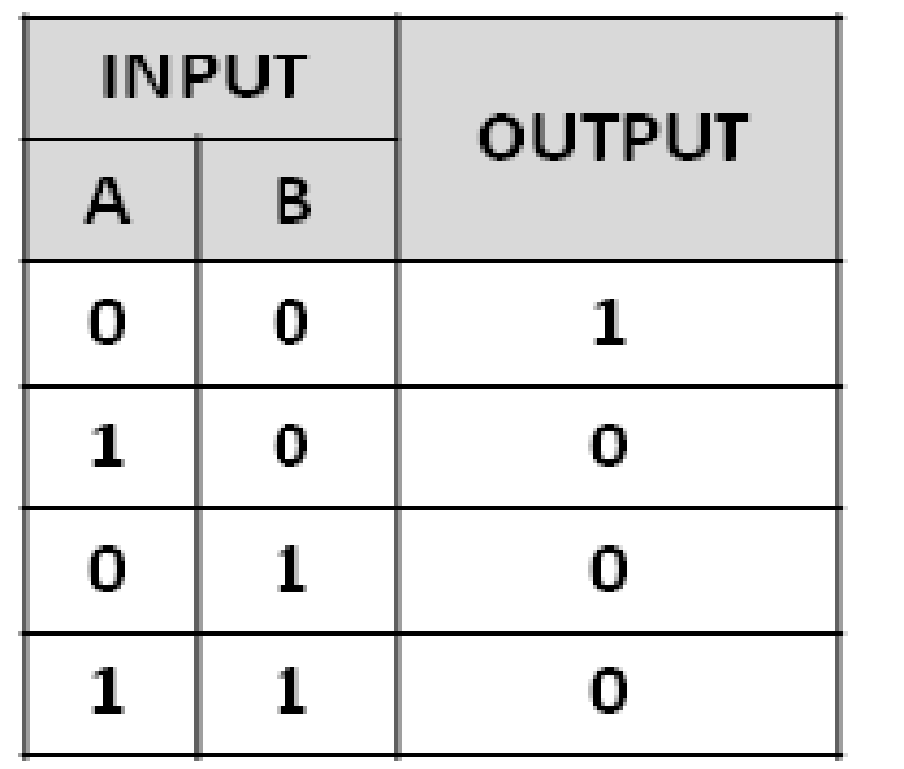
NOR Gate
Function: Outputs a 1 only if all inputs are 0, otherwise outputs 0. It is the inverse of the OR gate.
Inputs: A, B
Output: A NOR B
Truth Table: Symbol:

Slide 14
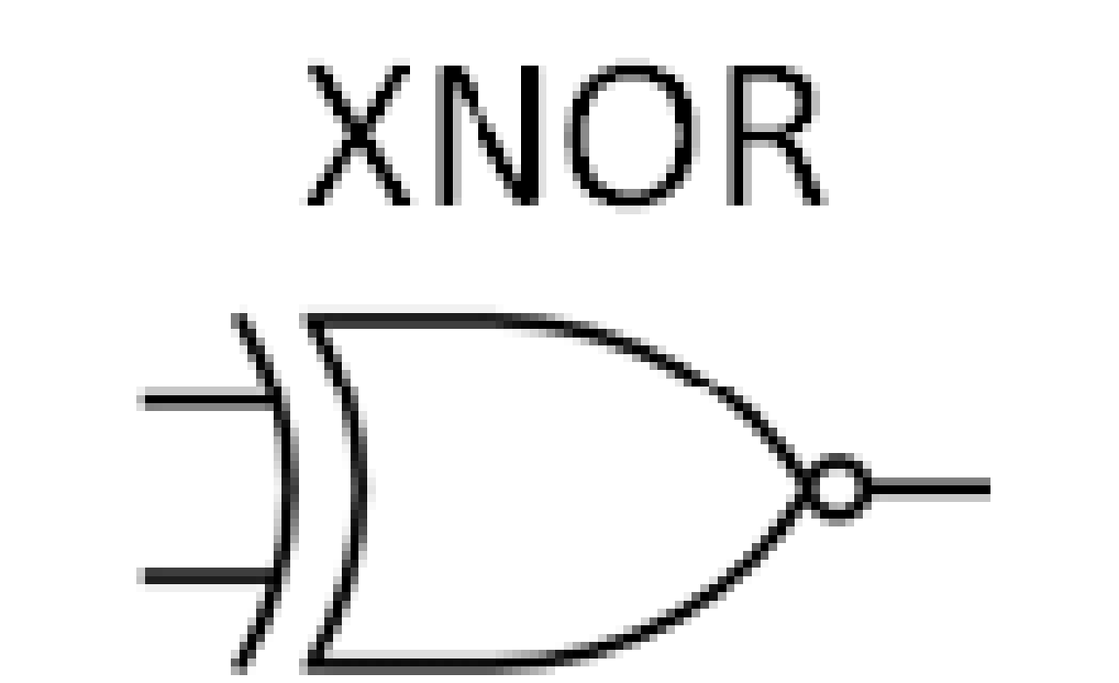
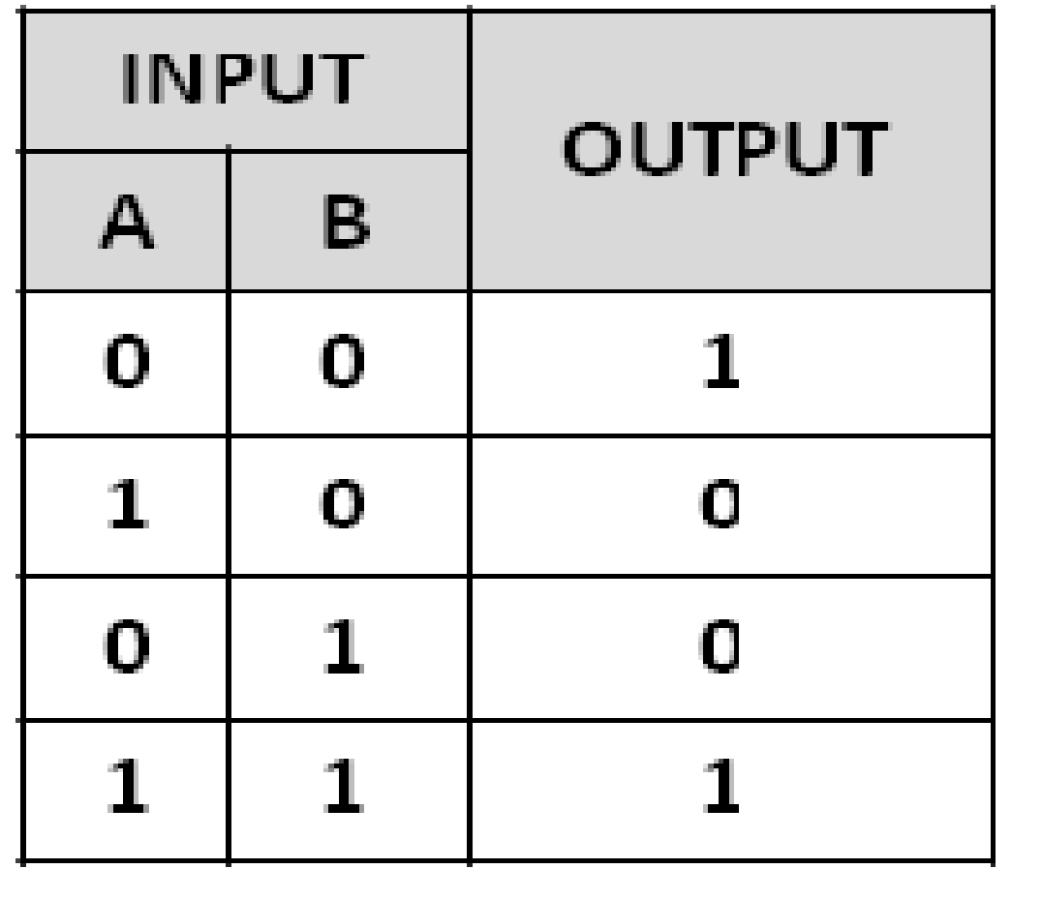
XOR Gate
Function: Outputs a 1 if the number of 1 inputs is odd. It outputs 0 if the inputs are equal.
Inputs: A, B
Output: A XOR B
Truth Table: Symbol:

Slide 15
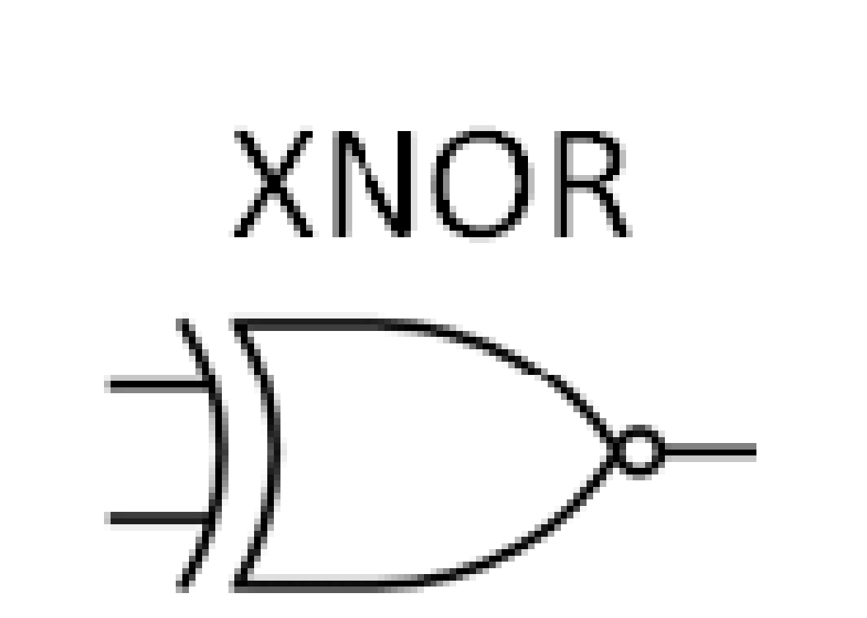
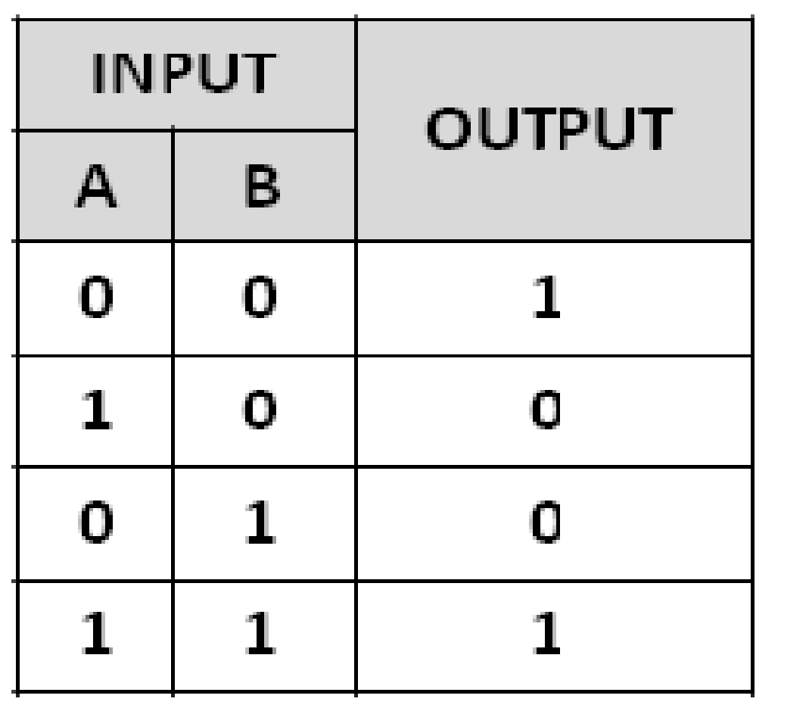
XNOR Gate
Function: Outputs a 1 if the inputs are equal (both 0 or both 1), otherwise outputs 0. It is the inverse of the XOR gate.
Inputs: A, B
Output: A XNOR B
Truth Table: Symbol:

Slide 16

Please share with your
connections to promote Tinkering

Slide 17


